Slide 1



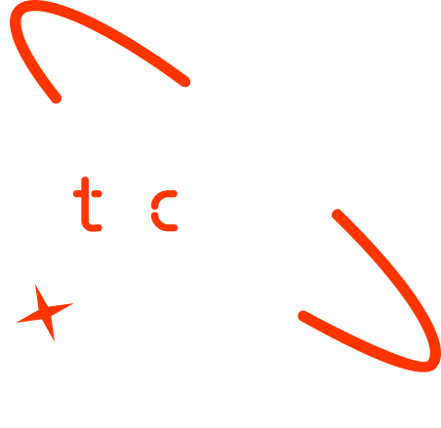

Real-Time Helmet Violation Detection
Presented by Group 7
Group Members
1. May Myat Noe Oo
2. Nay Chi Moe Oo
3. Min Sett Paing
4. Akeri Myint Zaw
5. May Phyo Thyu
6. Chan Aye Naing

Slide 2
Project Outline
Data Collection & Annotation
Dataset Preparation & Class Design
Data Collection & Annotation
Dataset Preparation & Class Design
Data Collection & Annotation
Dataset Preparation & Class Design
Concept note and implementation plan:
Background​
Objectives​
SDG Relation​
Data​
Data Collection​ and & Annotation
Dataset Preparation & Class Design
Model Selection and Training​
Model Evaluation and Hyperparameter Tuning​
Model Refinement and Testing​
Results​
Deployment​
Future Work

Slide 3
Background
Project Overview​
Motorcycle accidents are a major road safety issue in Myanmar, and many serious injuries occur because riders do not wear helmets properly
Helmet laws exist, but enforcement is mostly manual, time-consuming, and difficult to apply consistently in busy traffic areas.
This project uses computer vision and deep learning to automatically detect helmet compliance from traffic images, supporting data-driven road safety monitoring.

Slide 4
Project Objectives
Develop a real-time helmet detection system that accurately identifies helmet compliance in motorcycle traffic using a YOLOv8-based model.
Simplify enforcement-focused classification by detecting two clear outcomes: safe_helmet_on and rule_violation, ensuring practical real-world usability.
Build a scalable foundation that can later be extended with license plate recognition, dashboards, and decision-support tools for road safety authorities.

Slide 5



SDG Relation (Sustainable Development Goals)
SDG 3 – Good Health and Well-Being
The project supports road safety by detecting helmet rule violations, helping reduce head injuries and traffic fatalities.
SDG 9 – Industry, Innovation, and Infrastructure
Uses AI and computer vision to build an innovative, scalable system for modern traffic surveillance and safety analysis.
SDG 11 – Sustainable Cities and Communities
Automated traffic monitoring improves safer urban mobility and supports smarter, data-driven traffic management.

Slide 6
Dataset Annotation & Preparation
We used a publicly available motorcycle helmet dataset consisting of JPEG images and CSV annotation files, where each CSV contains bounding box coordinates and helmet-related labels.
A Python-based preprocessing pipeline was developed to match each CSV annotation with its corresponding image, convert bounding boxes into YOLO format, and prepare the data for model training.
To improve model stability and real-world usability, we merged the original 36 helmet-related classes into two meaningful classes:
safe_helmet_on – all riders on the motorcycle are wearing helmets
rule_violation – at least one rider is not wearing a helmet
Dataset Link ➔ https://hyper.ai/cn/datasets/32927

Slide 7
Model Selection and Training/Testing
Model Choice: YOLOv8n (Nano)
We selected YOLOv8n because it is lightweight, fast, and well-suited for real-time traffic surveillance.
Compared to larger models (e.g., YOLOv8s), YOLOv8n trains faster, requires fewer resources, and still provides reliable detection accuracy, making it practical for real-world deployment.
Training Strategy
The model was trained on our prepared image dataset using two classes:
safe_helmet_on / rule_violation
We split the data into training, validation, and test sets and used pretrained weights to improve convergence and training stability.
Testing and Evaluation
Model performance is evaluated using:
mAP@50 for detection accuracy
Precision and Recall for classification reliability
Inference speed (FPS) to confirm real-time feasibility

Slide 8
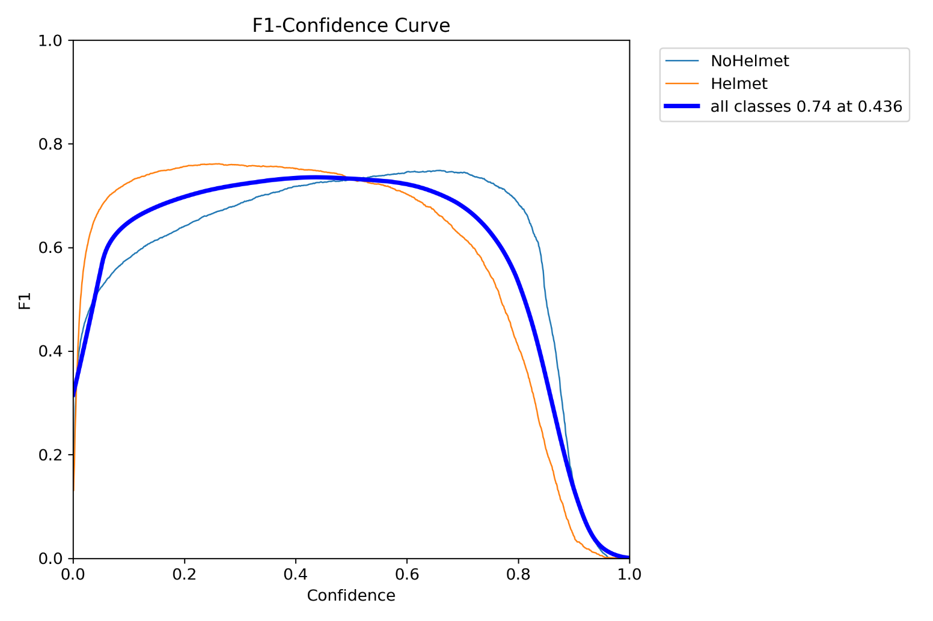
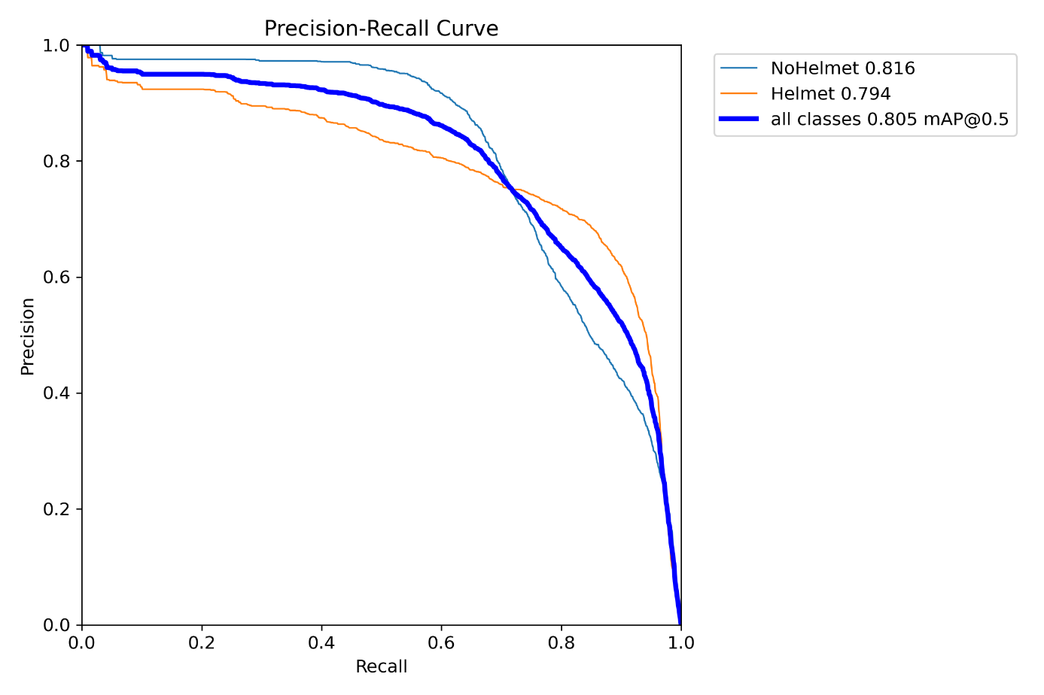
Evaluation Results (YOLOv8n)

Slide 9
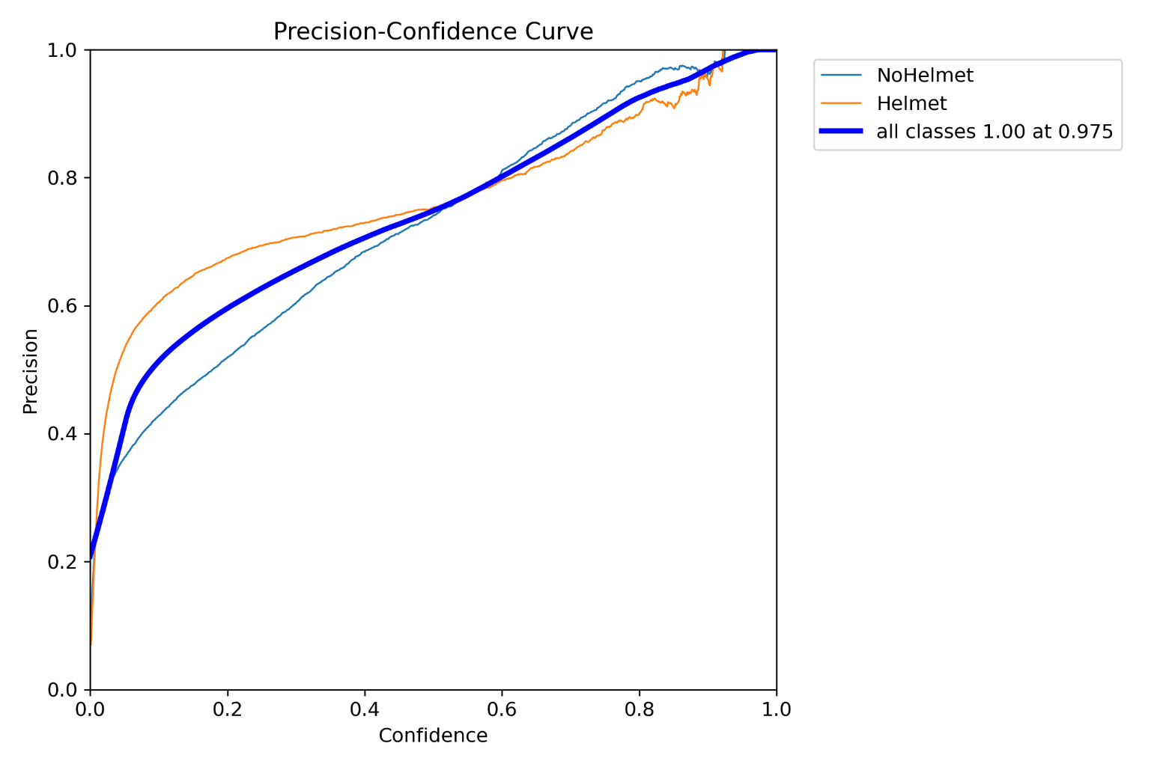
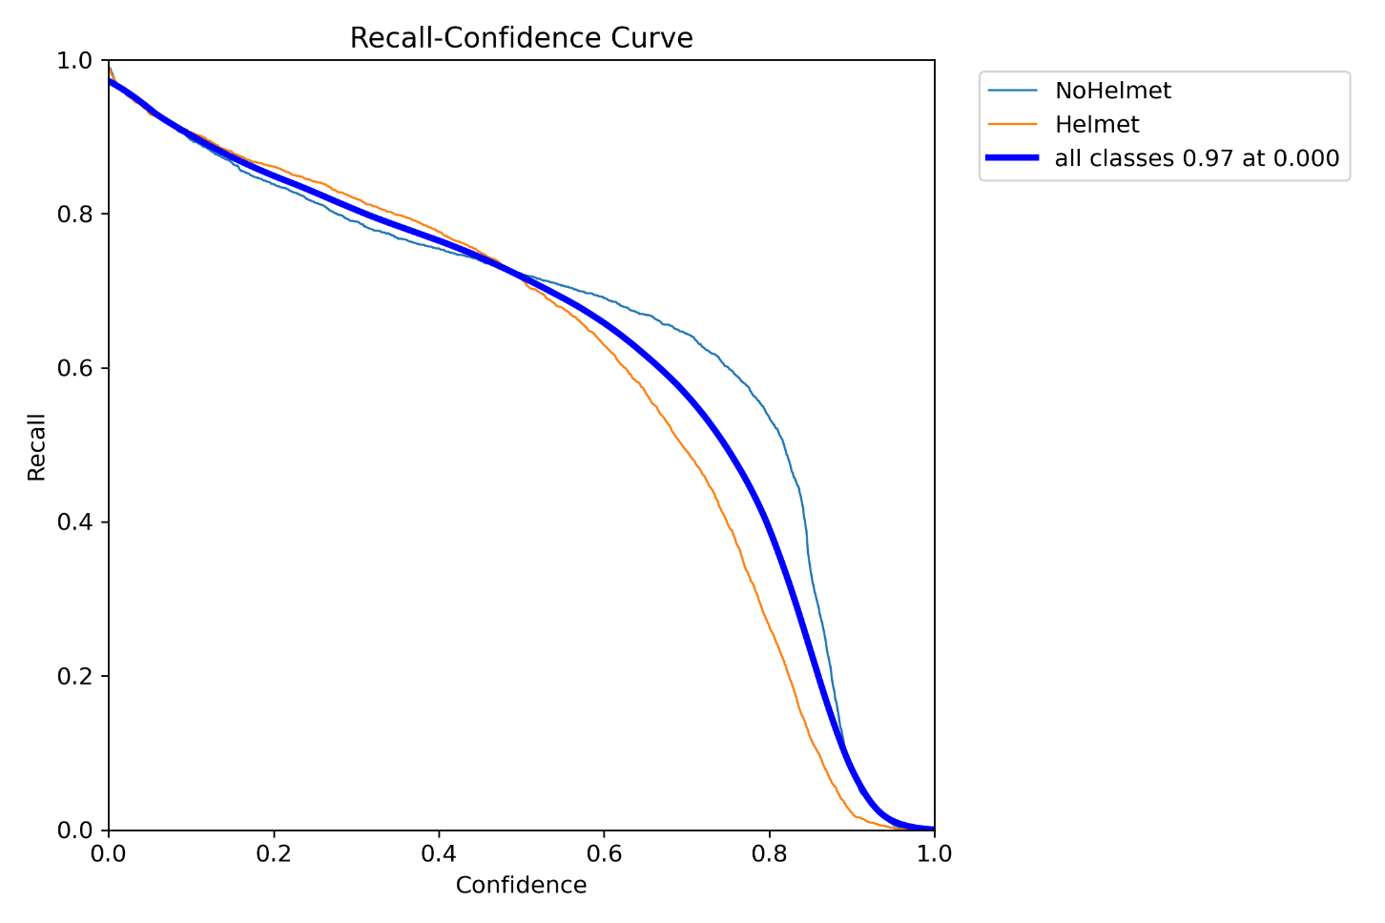
Evaluation Results (YOLOv8n)

Slide 10
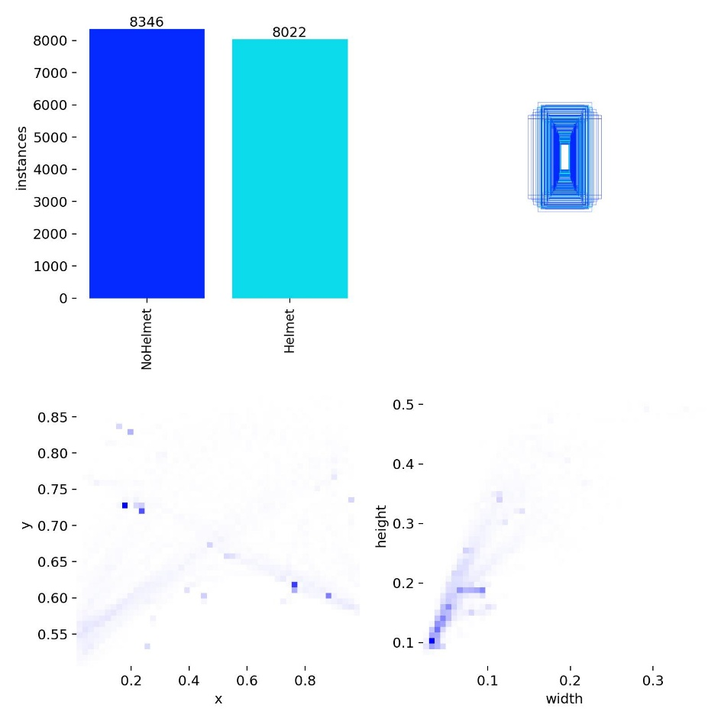
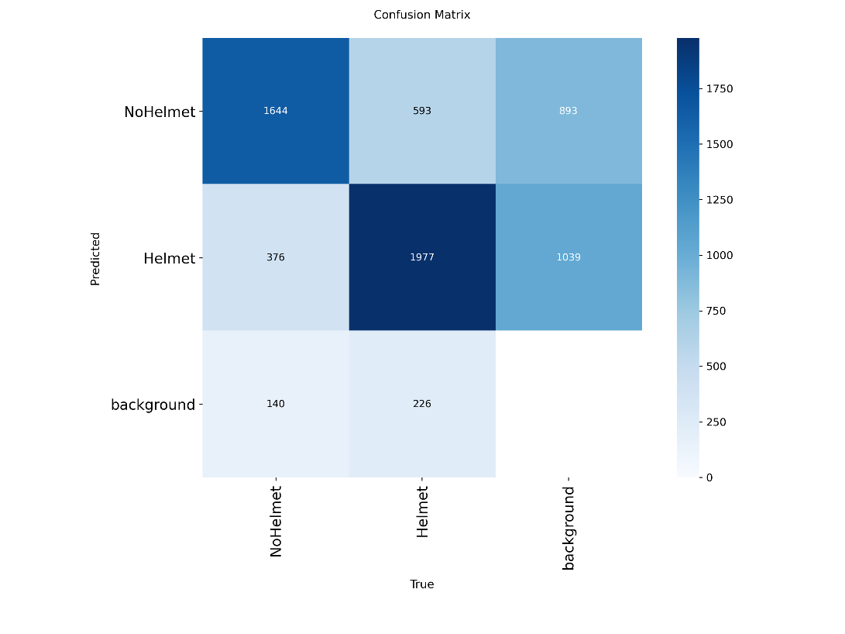
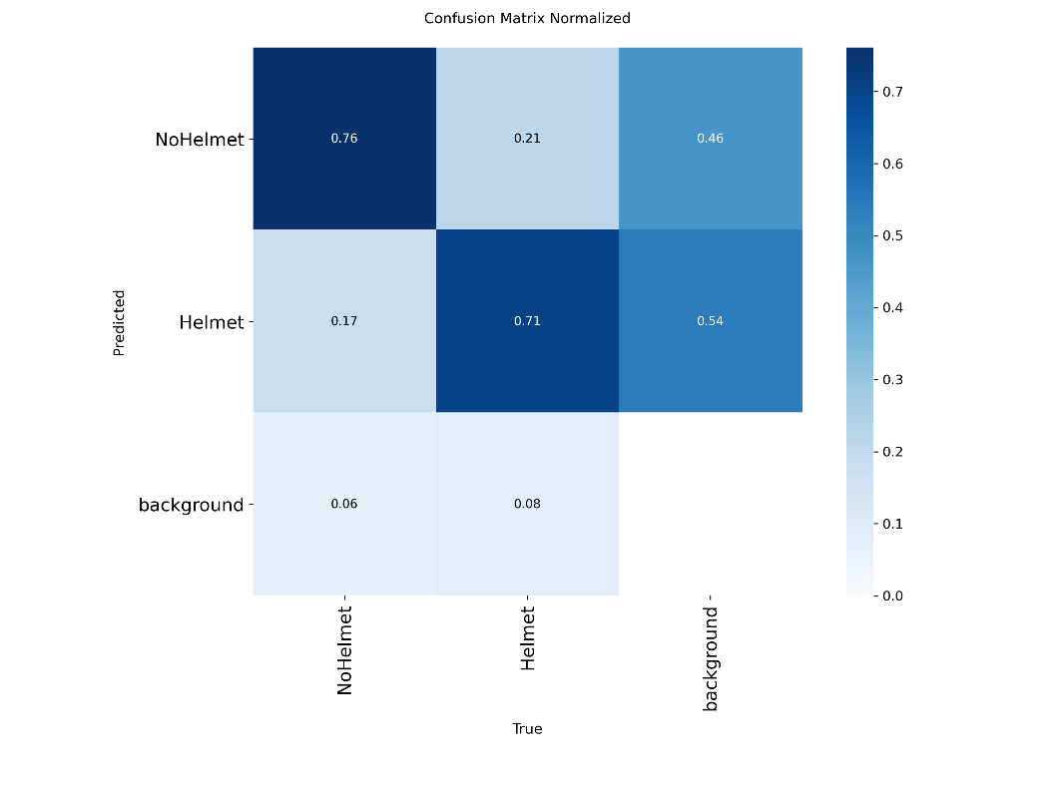
Evaluation Results (YOLOv8n)

Slide 11
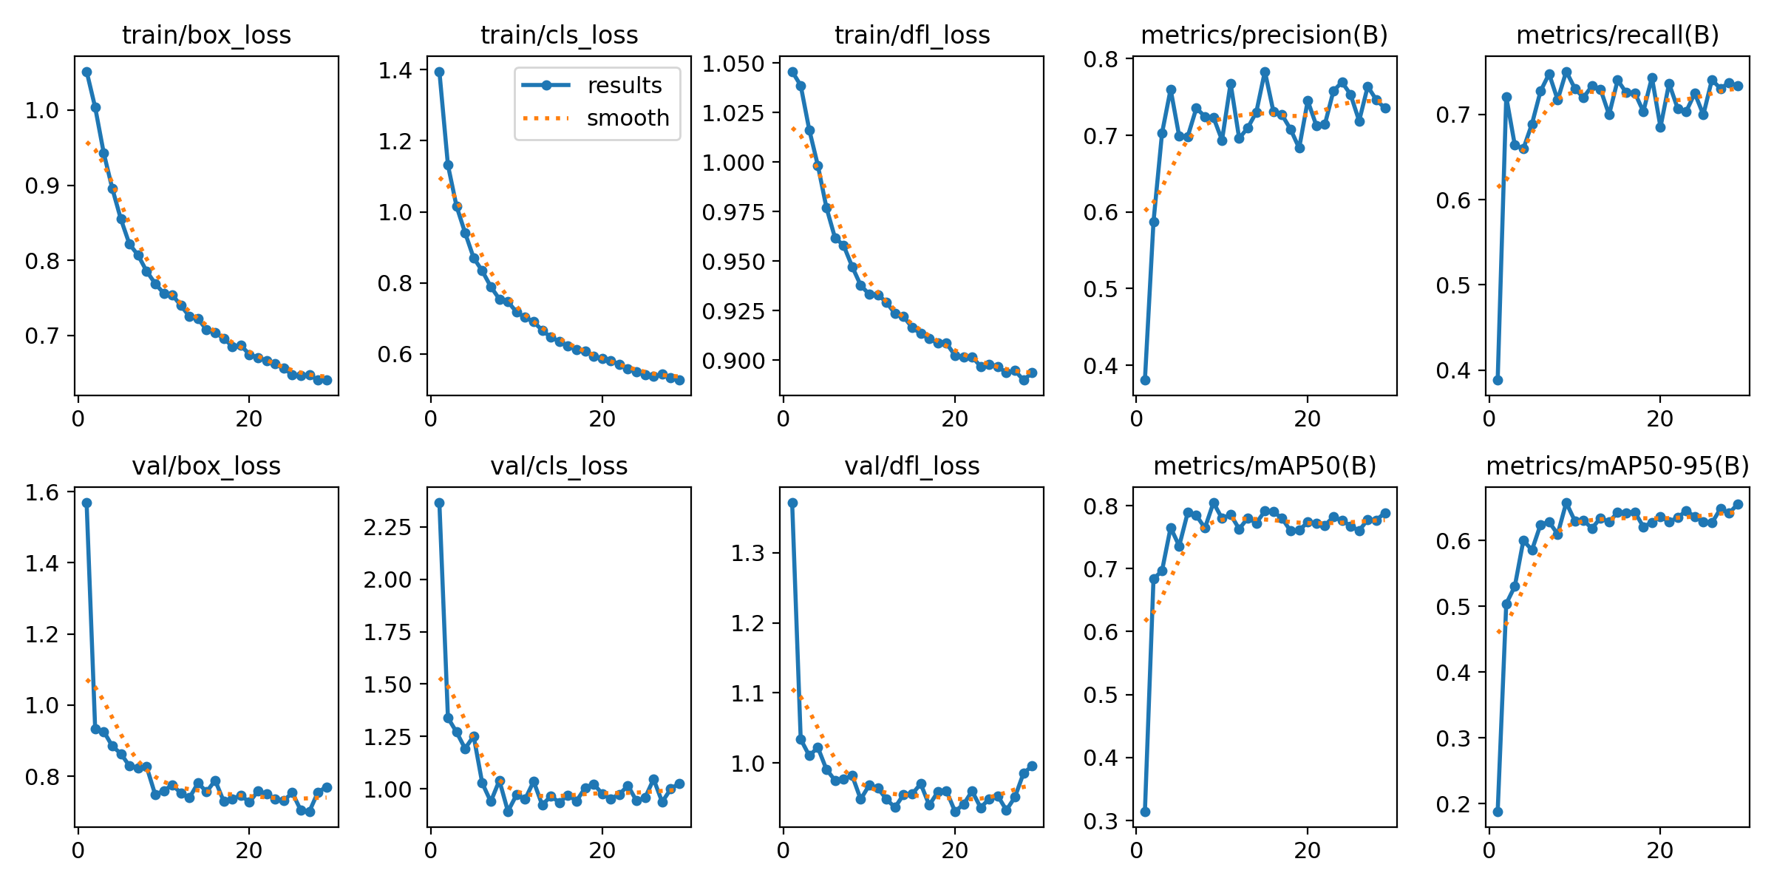
Evaluation Results (YOLOv8n)

Slide 12
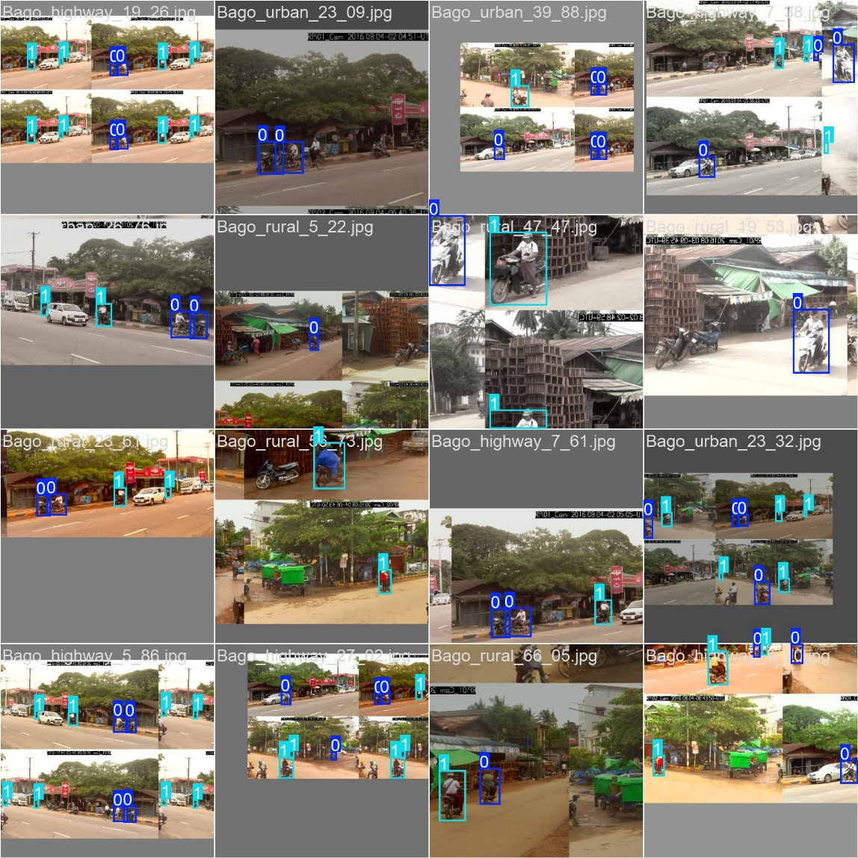
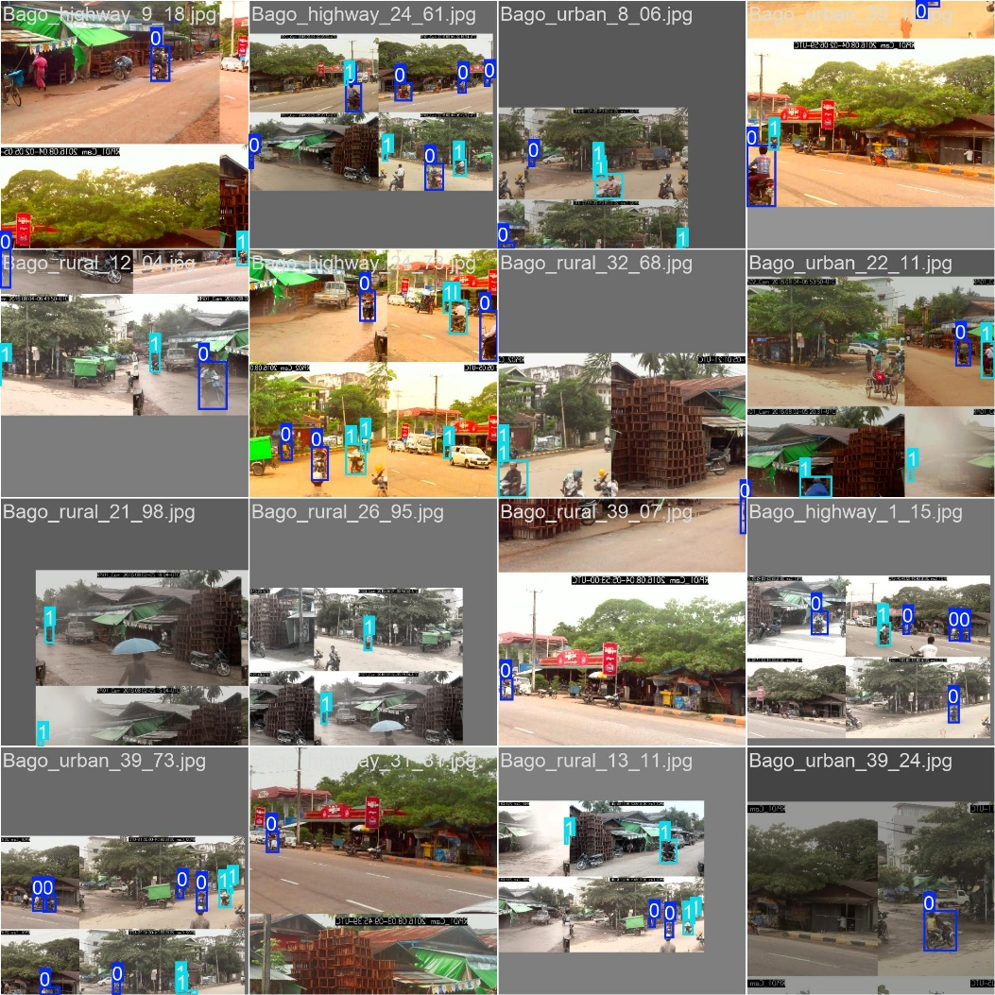
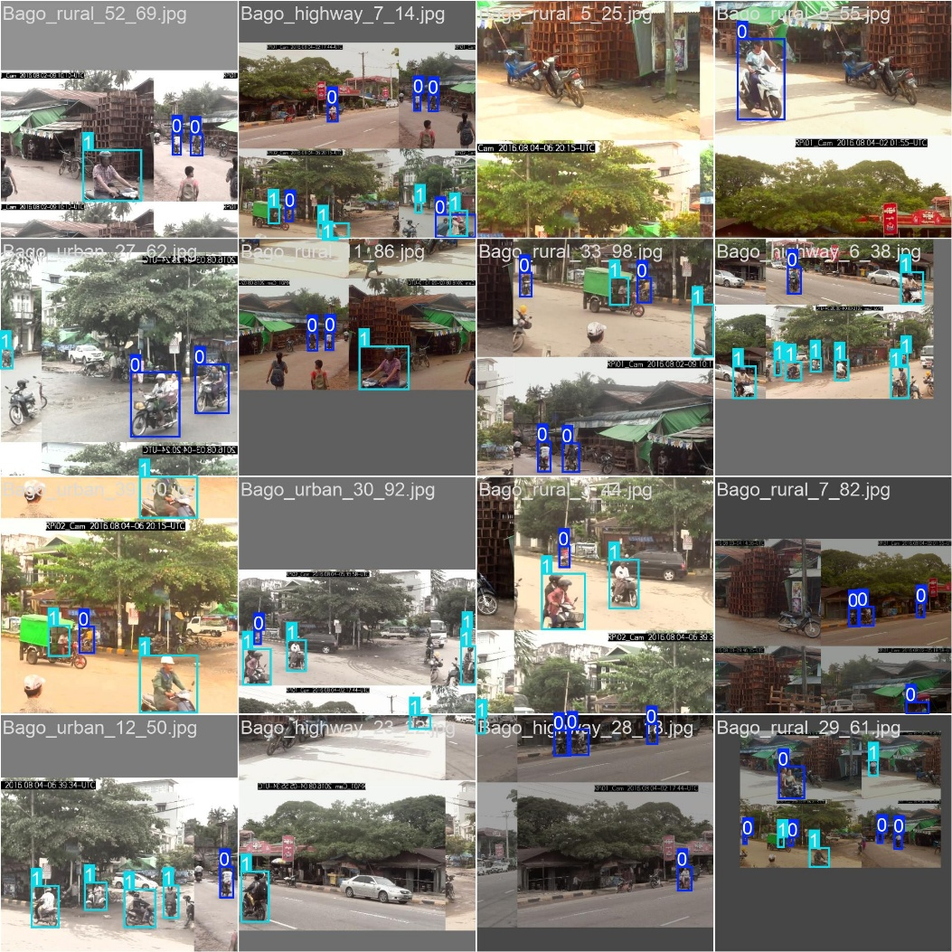
Evaluation Results (YOLOv8n)

Slide 13
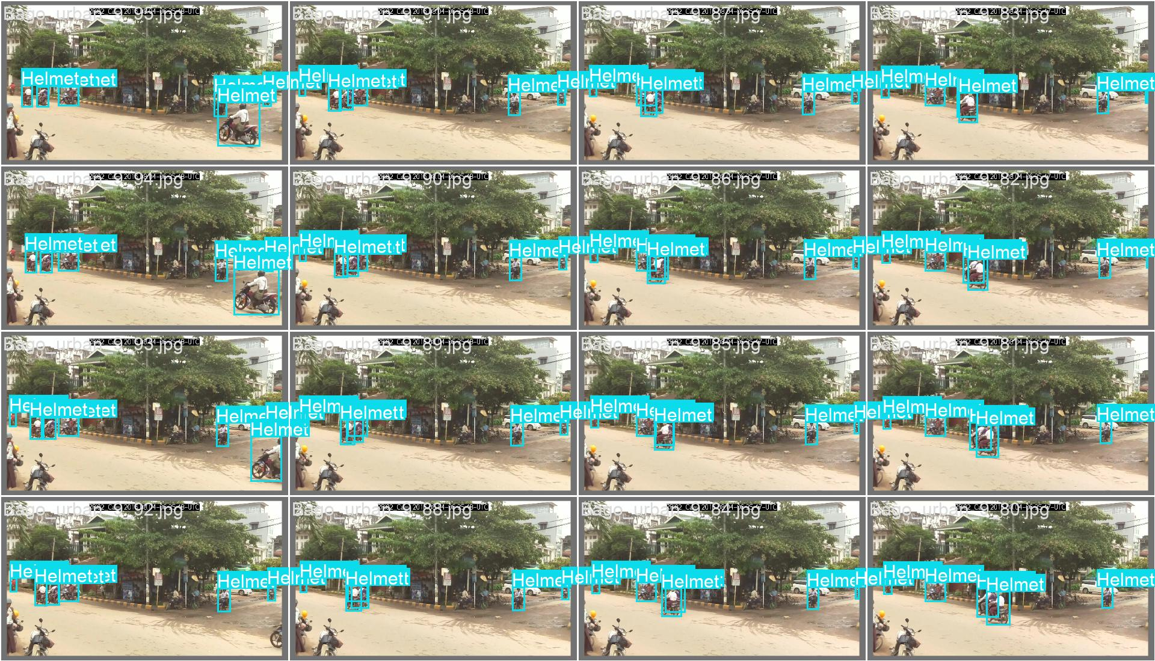
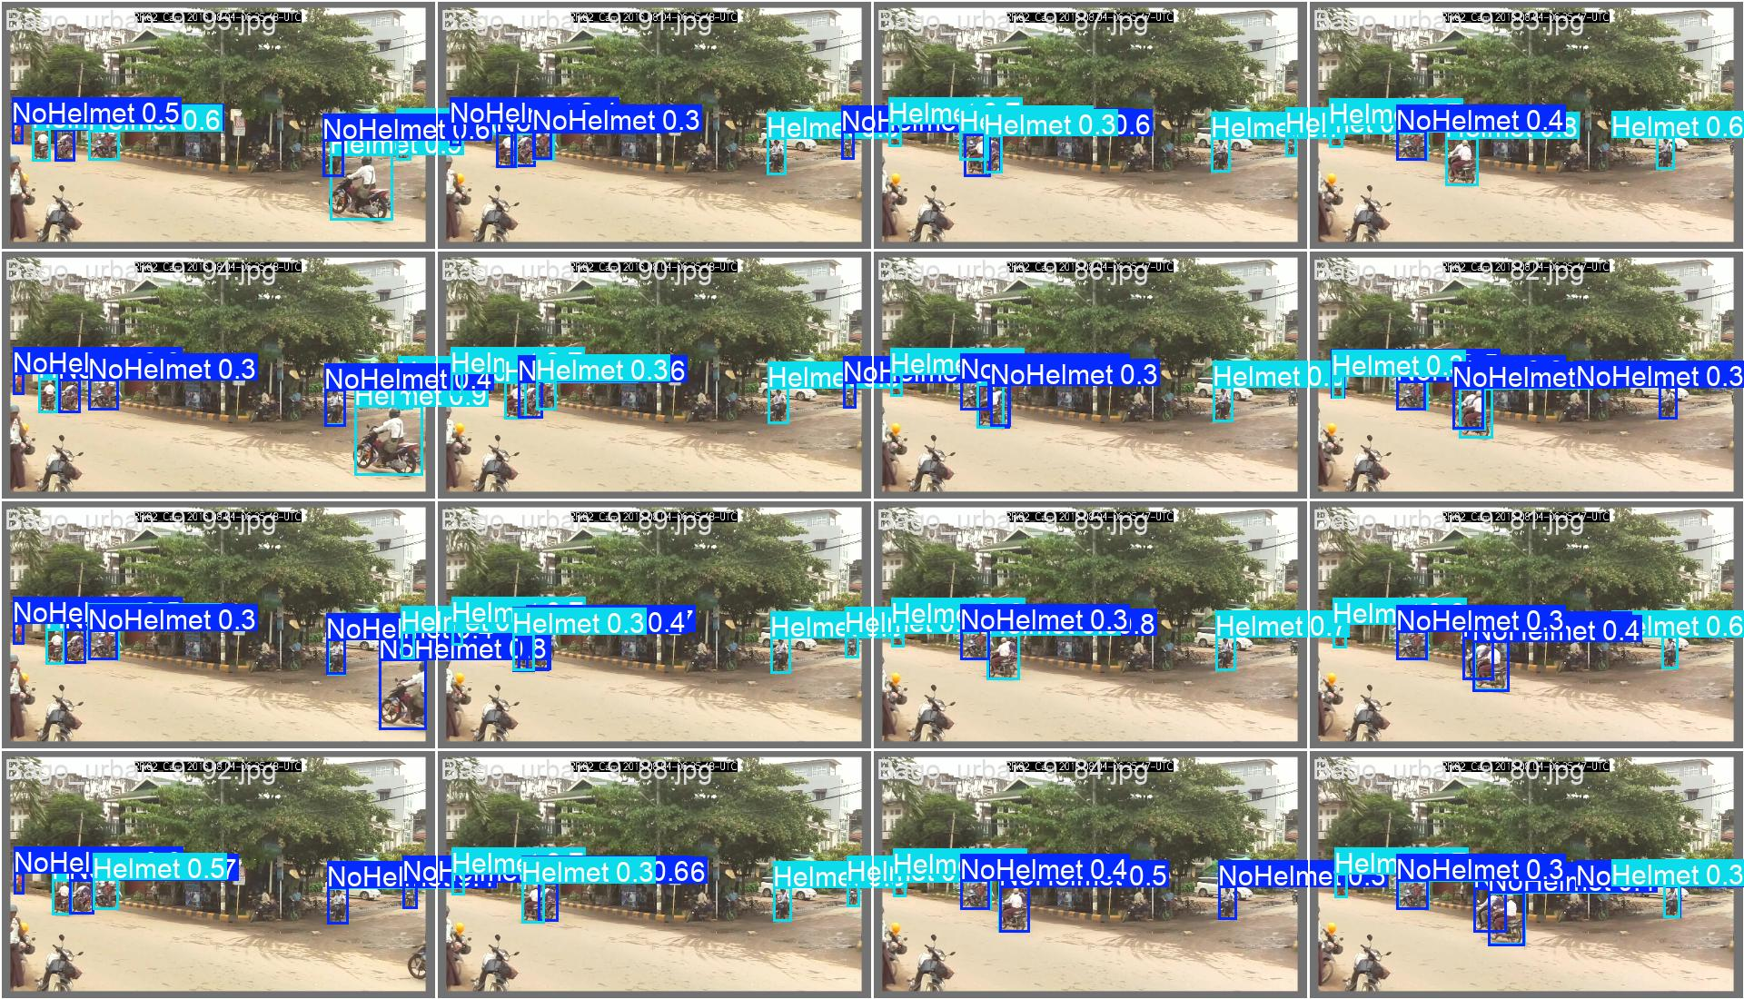
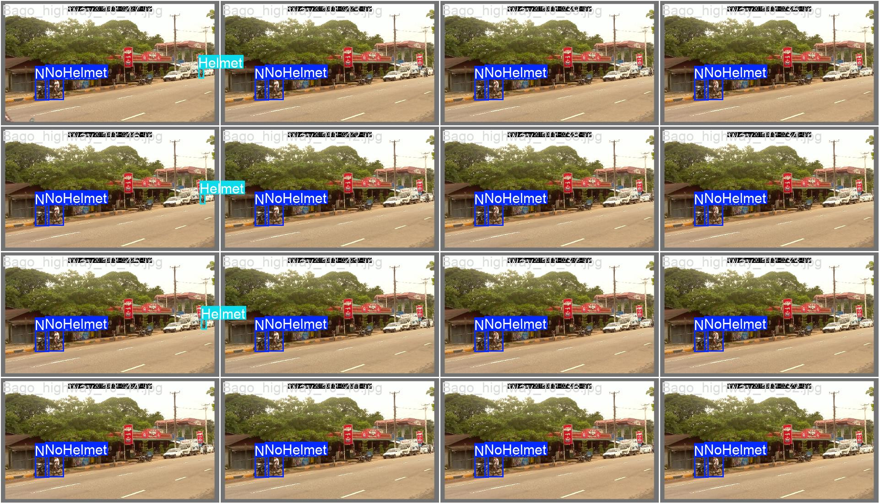
Evaluation Results (YOLOv8n)

Slide 14
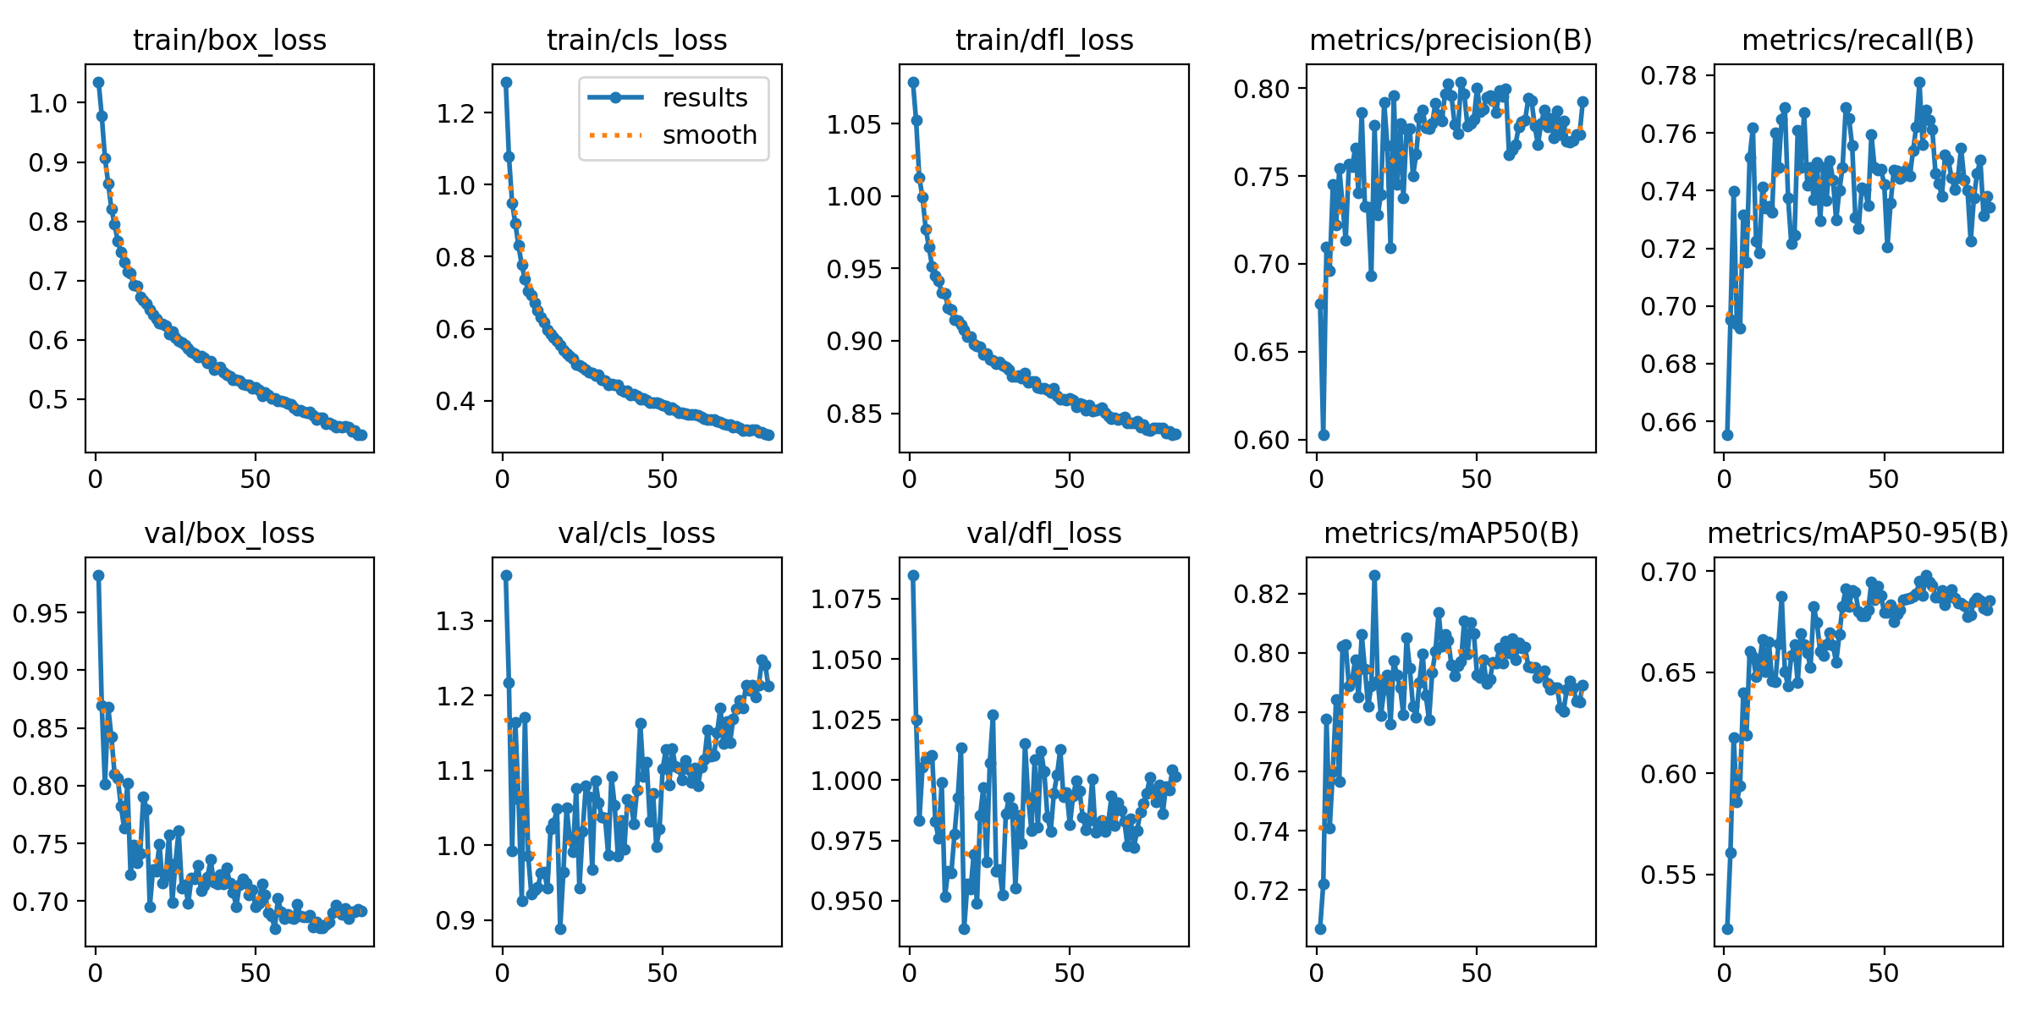
Evaluation Results (YOLOv8s)

Slide 15
Comparison Result (YOLOv8n and YOLOv8s)
Aspect | YOLOv8n (Nano) | YOLOv8s (Small)
Model Size | Very small, lightweight | Larger than nano
Training Time | Faster training | Slower training
mAP@50 | ~0.78 – 0.82 | Slightly higher but marginal gain
mAP@50–95 | ~0.65 – 0.70 | Slightly higher
Precision | Stable and consistent | Comparable
Recall | Stable | Comparable
Overfitting Risk | Lower | Higher on large, noisy datasets
Suitability for Real-Time Traffic Surveillance | ✅ Very suitable | ⚠️ Less suitable
Final Choice for Project | ✅ Selected | ❌ Not selected

Slide 16
Deployment
Model Serialization The trained YOLOv8n helmet detection model is saved as a lightweight .pt file, allowing it to be easily loaded for inference without retraining.
Model Serving The model is served using a FastAPI backend, enabling real-time image inference through a REST API. This setup ensures low-latency predictions suitable for traffic surveillance use cases.
API Integration The API accepts image inputs, runs helmet detection, and returns structured outputs including detected class labels and confidence scores. The system is containerized with Docker to ensure portability and consistent deployment across environments.

Slide 17
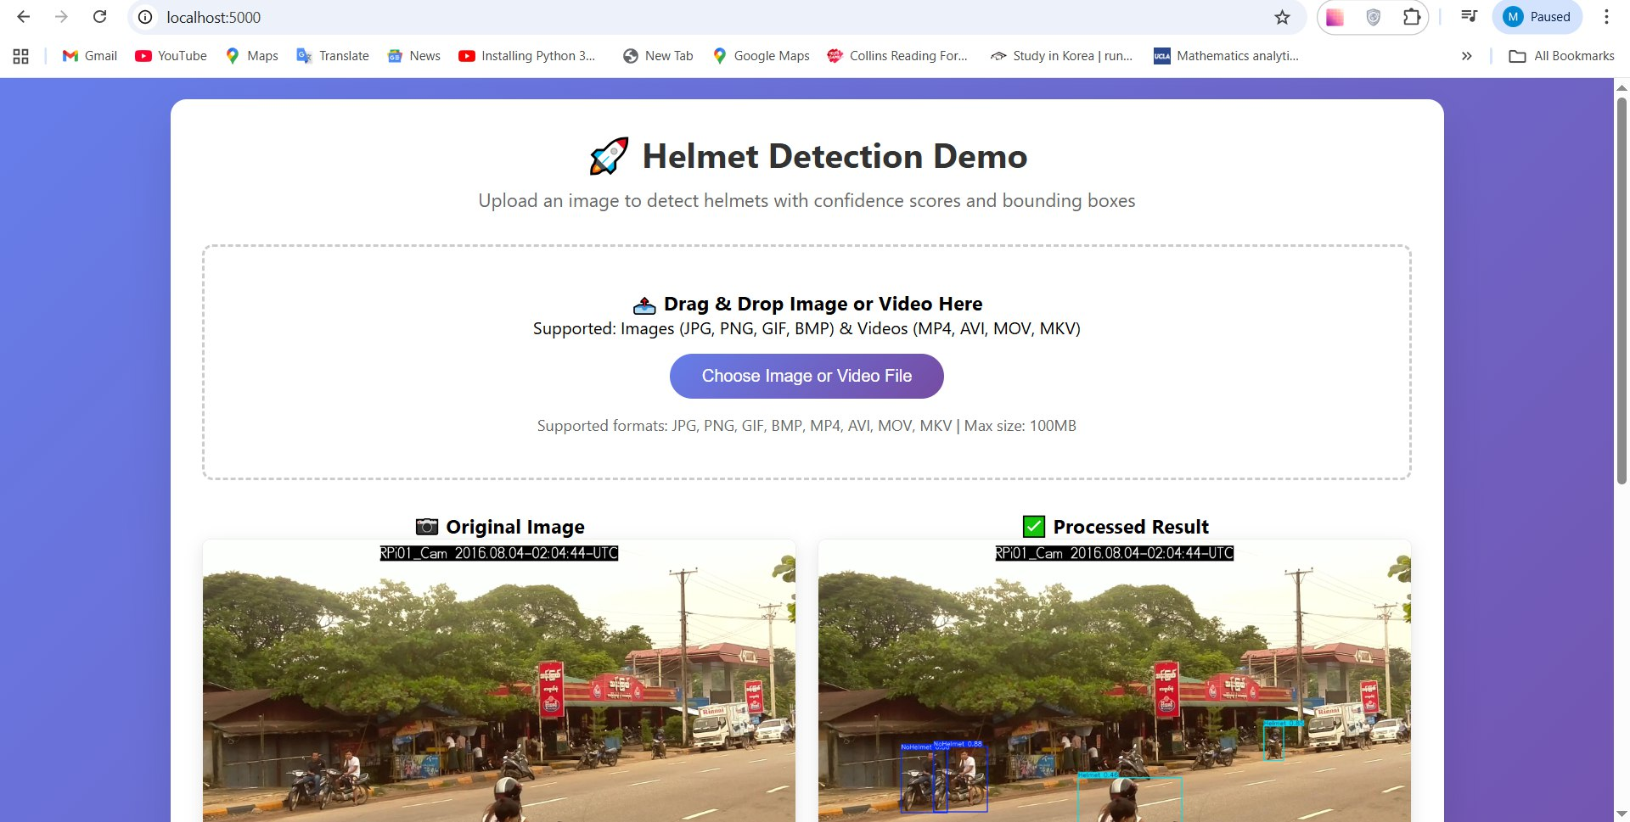
Deployment
Deployed System Interface

Slide 18
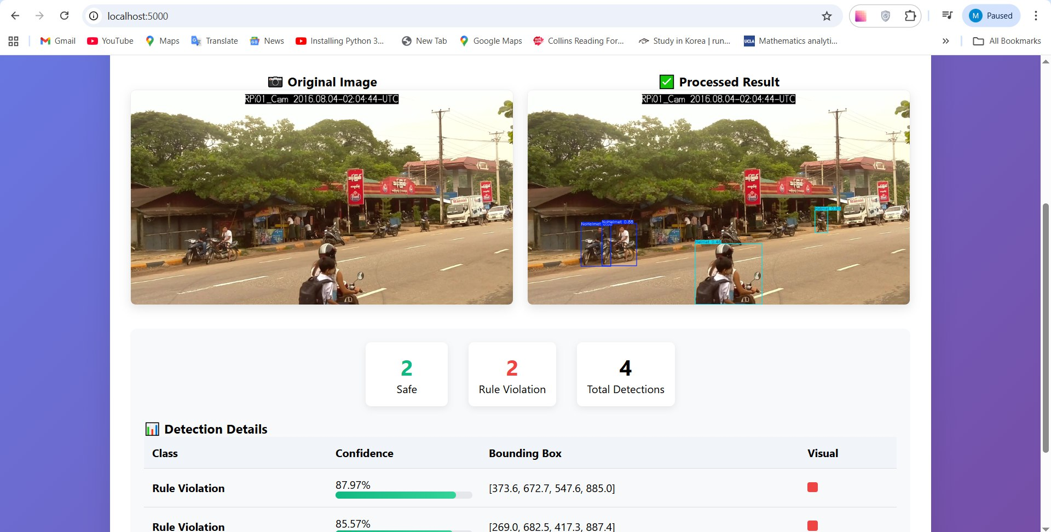
Deployment
Deployed System Interface

Slide 19
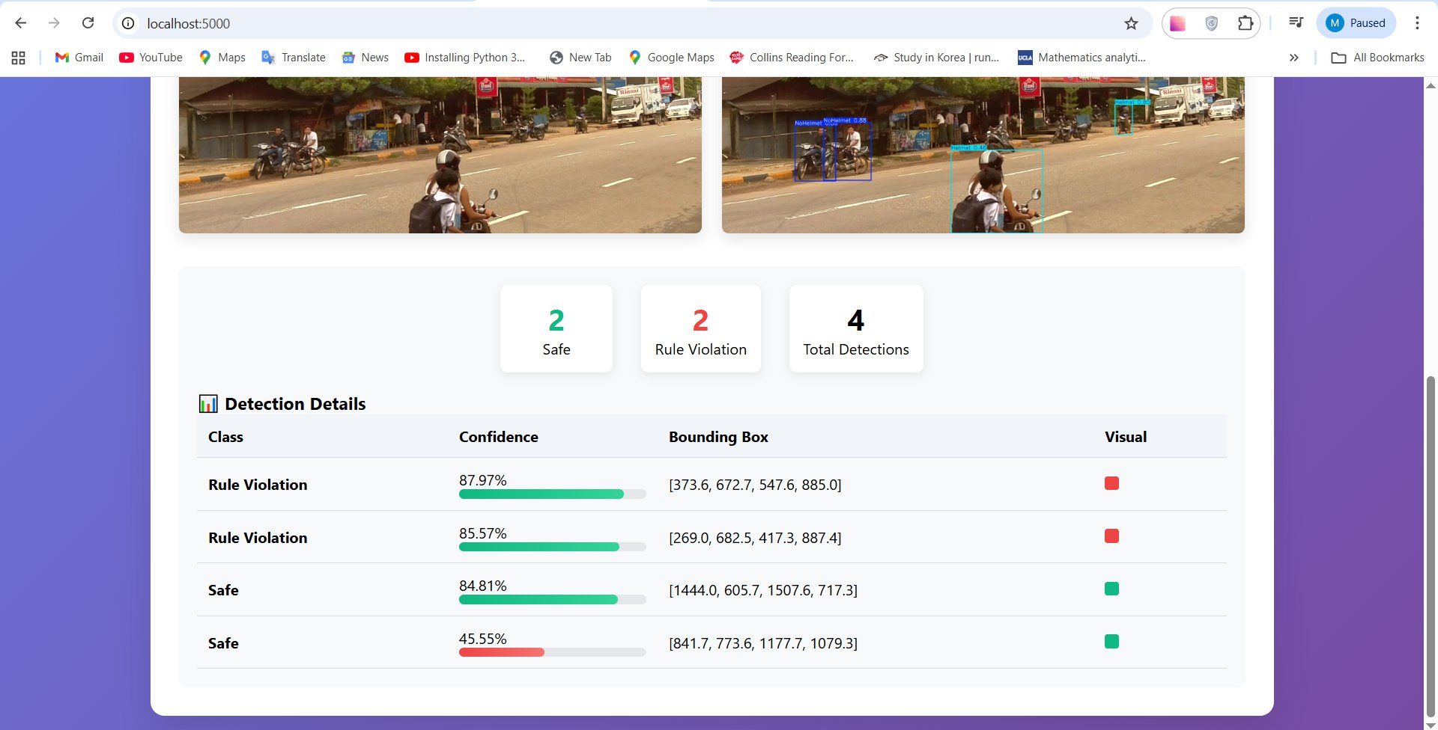
Deployment
Deployed System Interface

Slide 20
Deployment
Demonstration

Slide 21
Conclusion and Futurework
Conclusion
We successfully built a real-time helmet detection system using YOLOv8n, trained on a large, well-prepared image dataset.
2 classes (safe_helmet_on / rule_violation) significantly improved training stability, accuracy, and real-world usability.
The final YOLOv8n model achieves a good balance between accuracy and speed, making it suitable for traffic surveillance scenarios.
Future Work
Integrate license plate recognition (OCR) with proper evaluation and confidence handling.
Improve robustness using multi-angle and multi-region datasets from diverse traffic scenes.
Develop a simple dashboard to visualize helmet violations by time and location for decision support.

Slide 22


Thank you!

